Slide 1
Comprehensive Container Based Service Monitoring with Kubernetes and Istio
OSCON 2018
Fred Moyer
https://www.slideshare.net/redhotpenguin/comprehensive-container-based-service-monitoring-with-kubernetes-and-istio-106288073
@phredmoyer
Notes:
Hello, I’m Fred Moyer, and welcome to my talk. I’m here to speak about monitoring kubernetes container based services with Istio. This is a 3 and a half hour tutorial, so we’re going to be covering a few different subjects on Istio, and also get some hands on experience.

Slide 2
Monitoring Nerd @phredmoyer
Developer Evangelist @Circonus / @IRONdb
@IstioMesh Geek
Observability and Statistics Dork
@phredmoyer
Notes:
I’m a monitoring nerd and developer evangelist at Circonus. I’m an Istio geek, I created the first Istio community adapter for monitoring Istio based services with Circonus. The Istio developers gave me that ship in a bottle as a thank you for being the first person to implement a third party adapter.
I also like to dork out on observability and statistics.

Slide 3
Talk Agenda
Istio Overview
Exercises
Istio Mixer Metrics Adapters
Exercises
Math and Statistics
Exercises
SLOs / RED Dashboards
@phredmoyer
Notes:
So just a quick overview of the the talk roadmap. I’ll first give an overview of Istio and why it is awesome, then I’ll do a brief refresher on service level objectives to set a baseline. We’ll look at what a Red dashboard is and how we can make it more awesome with histogram based telemetry. Then I’ll do a brief walkthrough of the Istio metrics adapter I wrote, and finish up with a couple examples of how we can ask the right questions of the services we are monitoring.

Slide 4
Istio.io
“An open platform to connect, manage, and secure microservices”
@phredmoyer
Notes:
Let’s start off with Istio. Istio is a service mesh for Kubernetes, which means that it takes care of all of the intercommunication and facilitation between services, kind of like network routing software does for TCP/IP traffic. It can also interact with Docker and Consul based services in addition to Kubernetes based apps. It is similar to LinkerD, which has been around for a while.

Slide 5
Happy Birthday!
@phredmoyer
Notes:
Istio is developed as an open source project by teams at Google, IBM, and Lyft. The project just turned one year old a few weeks ago, and is rapidly approaching version 1.0. Version 0.8 was released just last week, and Istio has found its way into a couple of production environments at scale.

Slide 6
K8S + Istio
Orchestration
Deployment
Scaling
Data Plane
Policy Enforcement
Traffic Management
Telemetry
Control Plane
@phredmoyer
Notes:
So how does Istio fit into the Kubernetes ecosystem? Kubernetes handles container orchestration, deployment, and scaling. Kubernetes is the data plane, the part of the infrastructure that carries the application traffic.
Istio is the control plane, the part of the infrastructure that tells the application traffic where it can go. It handles policy enforcement such as role based access control, traffic management such as rate limiting, load balancing (think 5% of traffic can be routed to a canary instance), and telemetry syndication such as metrics, logs, and tracing. Istio is the crossing guard and reporting piece of the container based infrastructure.

Slide 7
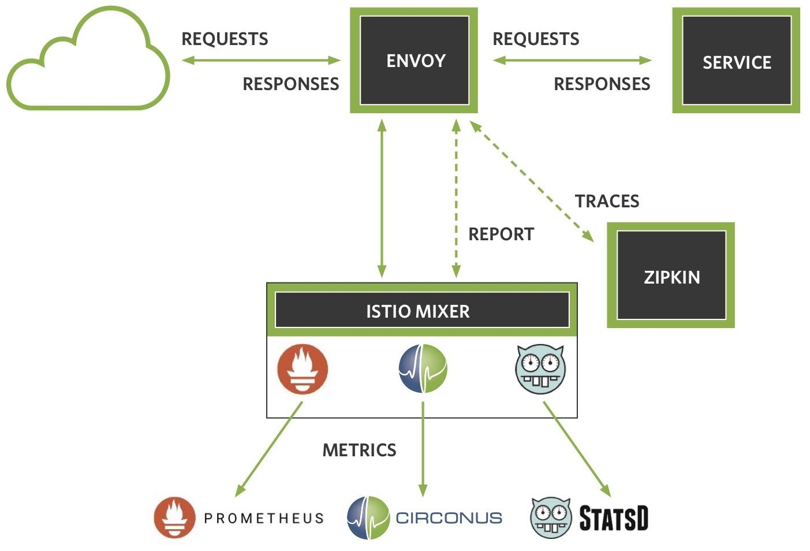
Istio Architecture
@phredmoyer
Notes:
Let’s take a quick look at the service mesh architecture. Istio uses an envoy sidecar proxy for each service. Envoy proxies inbound requests to the Istio Mixer service via a GRPC call, where Mixer applies rules for traffic management, and syndicates request telemetry. Mixer is the brains of Istio; operators can write YAML files that specify how Envoy should redirect traffic, and what telemetry to push to monitoring and observability systems. Rules can be applied as needed at runtime without needing to restart any Istio components.
Istio supports a number of adapters to send telemetry to prometheus, circonus, statsd, and others. You can also enable both zipkin and jaeger tracing, as well as generating service graphs to visualize the services involved.

Slide 8
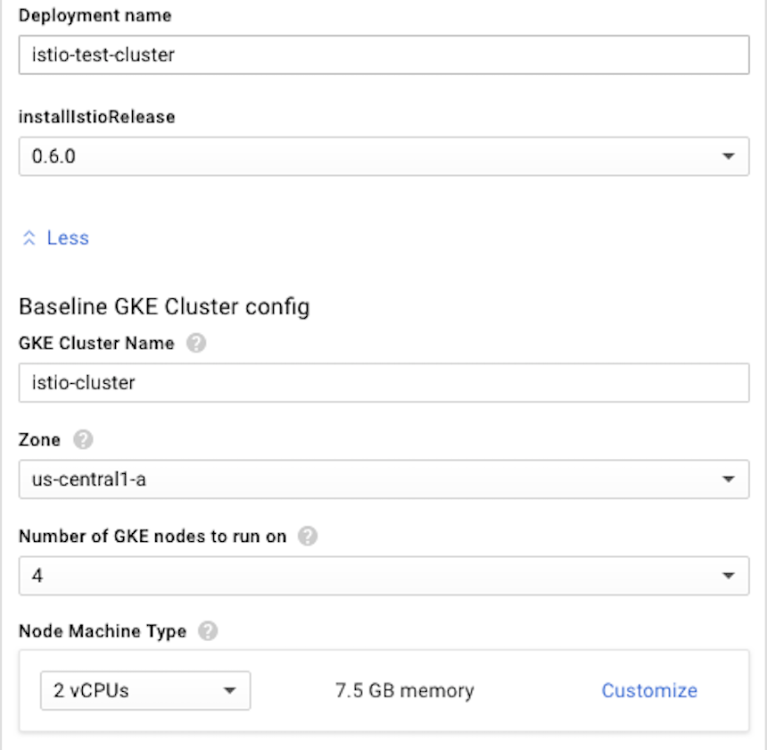
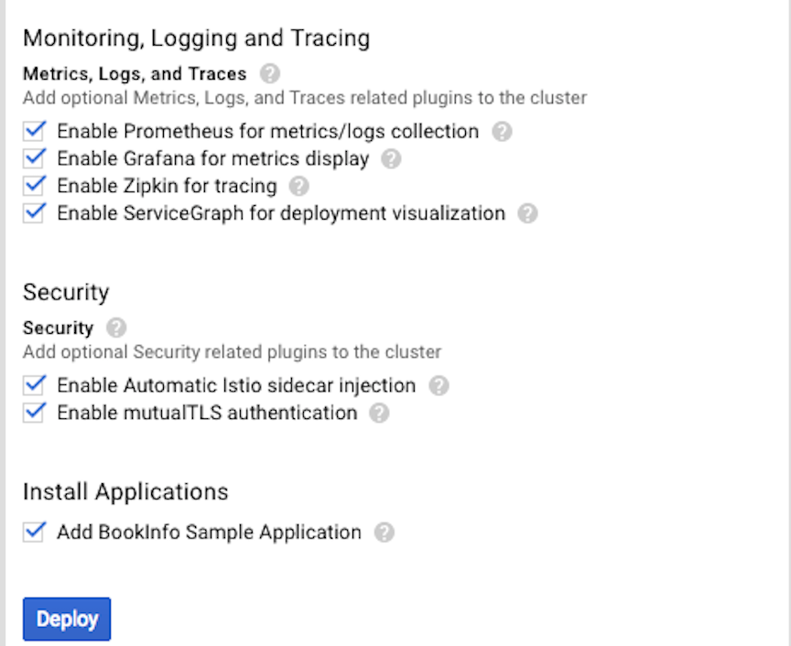
Istio GCP Deployment
@phredmoyer
Notes:
Istio is easy to deploy. Way back when, around 7 to 8 months ago, you had to install Istio onto a Kubernetes cluster with a series of kubectl commands. Now you can just hop into Google Cloud platform, and deploy an Istio enabled Kubernetes cluster with a few clicks, including monitoring, tracing, and a sample application. You can get up and running very quickly, and then use the istioctl command to start having fun.
Let’s take a look at how we can get going with istioctl.

Slide 9
Istio Sample App
$ istioctl create -f apps/bookinfo.yaml
@phredmoyer
Notes:
Istio is managed with a command line executable called istio control (or is it istio cuddle?). Istioctl operates on YAML files which specify resource deployments similar to how kubectl operates with Kubernetes.
I’ll show a couple of examples of these yaml files in a few slides, but first let’s see what we get when we run this command against our Istio enabled Kubernetes cluster.

Slide 10
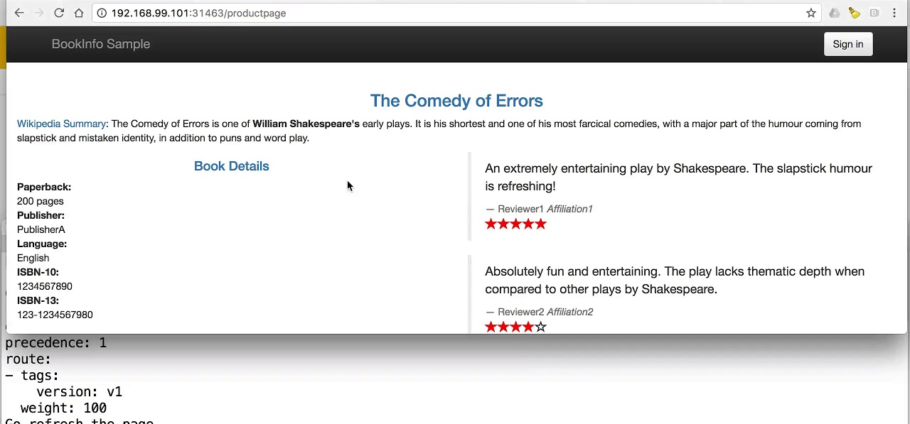
Istio Sample App
@phredmoyer
Notes:
And boom, we have the sample application up and running. This sample app is basically a book review application which allows us to demonstrate a lot of the Istio functiolity. At the bottom of the screen, you can see where Istio can provide information about app routing weight, app version, and other metadata.

Slide 11
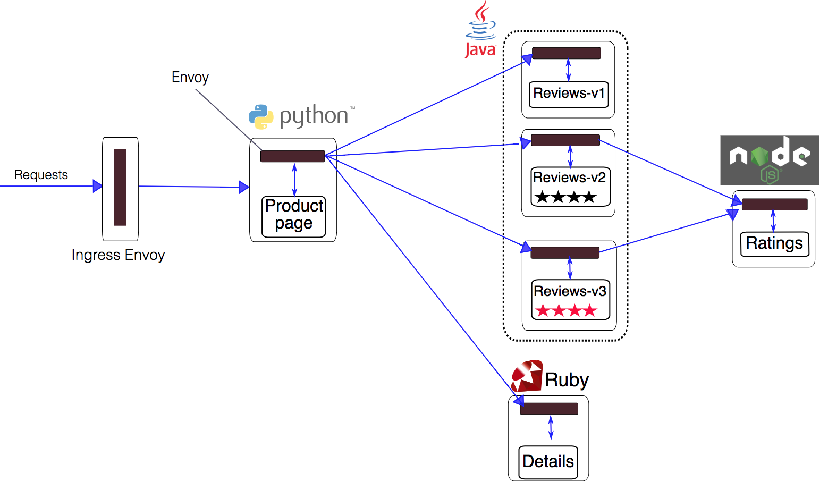
Istio Sample App
@phredmoyer
Notes:
Here’s the sample bookinfo application that ships with istio. It has several different microservices written in different language. So instead of listening to folks complain about why their language is better than what your organization is using, you can make those tactics part of your strategic plan, let folks use their language of choice, and be rid of the programming language wars in your group. Instead, you can get everyone back to arguing about tabs vs spaces.
This layout shows a product page service, a book details page service, three different versions of a reviews service, and a ratings service. Istio allows you to abstract a service such as the reviews service behind different versions of container deployments. You can configure Istio to route different levels of traffic to each set of pods for functionality such as canary deployments.
You’ll notice that there’s an envoy sidecar present in each service. Envoy is very high performance, so this doesn’t actually present noticeable performance problems.
Another significant benefit of this architecture is that it allows us to gather telemetry from services without requiring that developers instrument their services to provide that telemetry. This has a multitude of benefits, from eliminating points of maintenance and failure in the code, to providing vendor agnostic interfaces which reduce lockin.

Slide 12
Istio Sample App
kind: Deployment
metadata:
name: ratings-v1
spec:
replicas: 1
template:
metadata:
labels:
app: ratings
version: v1
spec:
containers:
- name: ratings
image: istio/examples-bookinfo-ratings-v1
imagePullPolicy: IfNotPresent
ports:
- containerPort: 9080
@phredmoyer
Notes:
The bookinfo.yaml file contains pragmas which specify different services. This particular section contains the information to setup the v1 ratings service. We specify a name for the service, version, container port, and the docker image to pull.
This type of approach makes it fairly easy to codify a microservice based application.

Slide 13
Istio Sample App
$ istioctl create -f apps/bookinfo/route-rule-reviews-v2-v3.yaml
type: route-rule spec: name: reviews-default destination: reviews.default.svc.cluster.local precedence: 1 route: - tags: version: v2 weight: 80 - tags: version: v3 weight: 20
@phredmoyer
Notes:
We can apply yaml based rules at runtime to tell Istio that we want to change the traffic distribution between different versions of services.
In this example, we direct Istio to send 80% of the requests to version 2 of the reviews service, and 20% of the requests to version 3 of the reviews service. This makes canary deployments straightforward to execute. You can send a small portion of your traffic to the new version of your service, apply a routing rule like this, and examine your telemetry and logs to determine if your new version is behaving as expected.
This does mean that you are in effect testing in production, but often there is no substitute for this approach to verify code is working as expected.

Slide 14
Istio K8s Services
> kubectl get services
NAME CLUSTER-IP EXTERNAL-IP PORT(S) AGE details 10.0.0.31 <none> 9080/TCP 6m kubernetes 10.0.0.1 <none> 443/TCP 7d productpage 10.0.0.120 <none> 9080/TCP 6m ratings 10.0.0.15 <none> 9080/TCP 6m reviews 10.0.0.170 <none> 9080/TCP 6m
@phredmoyer
Notes:
Here’s a look inside at what Kubernetes services are exposed by this sample application. Our sample application is composed of four total services, excluding the kubernetes system service.
We have separate services for the book details page, the product page, the ratings page, and the reviews page. Let’s take a look at the pods that compose these services.

Slide 15
Istio K8s App Pods
> kubectl get pods
NAME READY STATUS RESTARTS AGE details-v1-1520924117 2/2 Running 0 6m productpage-v1-560495357 2/2 Running 0 6m ratings-v1-734492171 2/2 Running 0 6m reviews-v1-874083890 2/2 Running 0 6m reviews-v2-1343845940 2/2 Running 0 6m reviews-v3-1813607990 2/2 Running 0 6m
@phredmoyer
Notes:
Here are the individual pods deployed which compose those services. Notice the three different versions of the reviews pods which make up the reviews service. As we just saw, we can deploy different versions of individual services and weight the traffic between them.

Slide 16
Istio K8s System Pods
> kubectl get pods -n istio-system
NAME READY STATUS RESTARTS AGE
istio-ca-797dfb66c5 1/1 Running 0 2m
istio-ingress-84f75844c4 1/1 Running 0 2m
istio-egress-29a16321d3 1/1 Running 0 2m
istio-mixer-9bf85fc68 3/3 Running 0 2m
istio-pilot-575679c565 2/2 Running 0 2m
grafana-182346ba12 2/2 Running 0 2m
prometheus-837521fe34 2/2 Running 0 2m
@phredmoyer
Notes:
Istio itself makes use of a number of different pods to operate itself. I didn’t say that running Istio is lightweight; the power and flexibility come with some overhead for operation. If you have more than a few microservices though in your application, your application containers will soon surpass the system provisioned containers though.

Slide 17
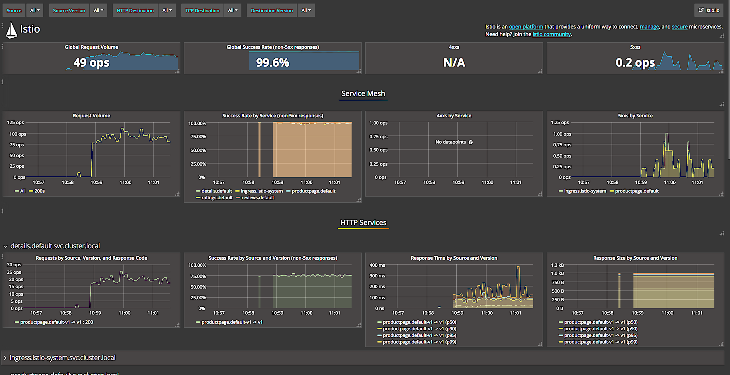
Istio Grafana Dashboard
@phredmoyer
Notes:
Istio actually provides us with a Grafana dashboard out of the box.

Slide 18
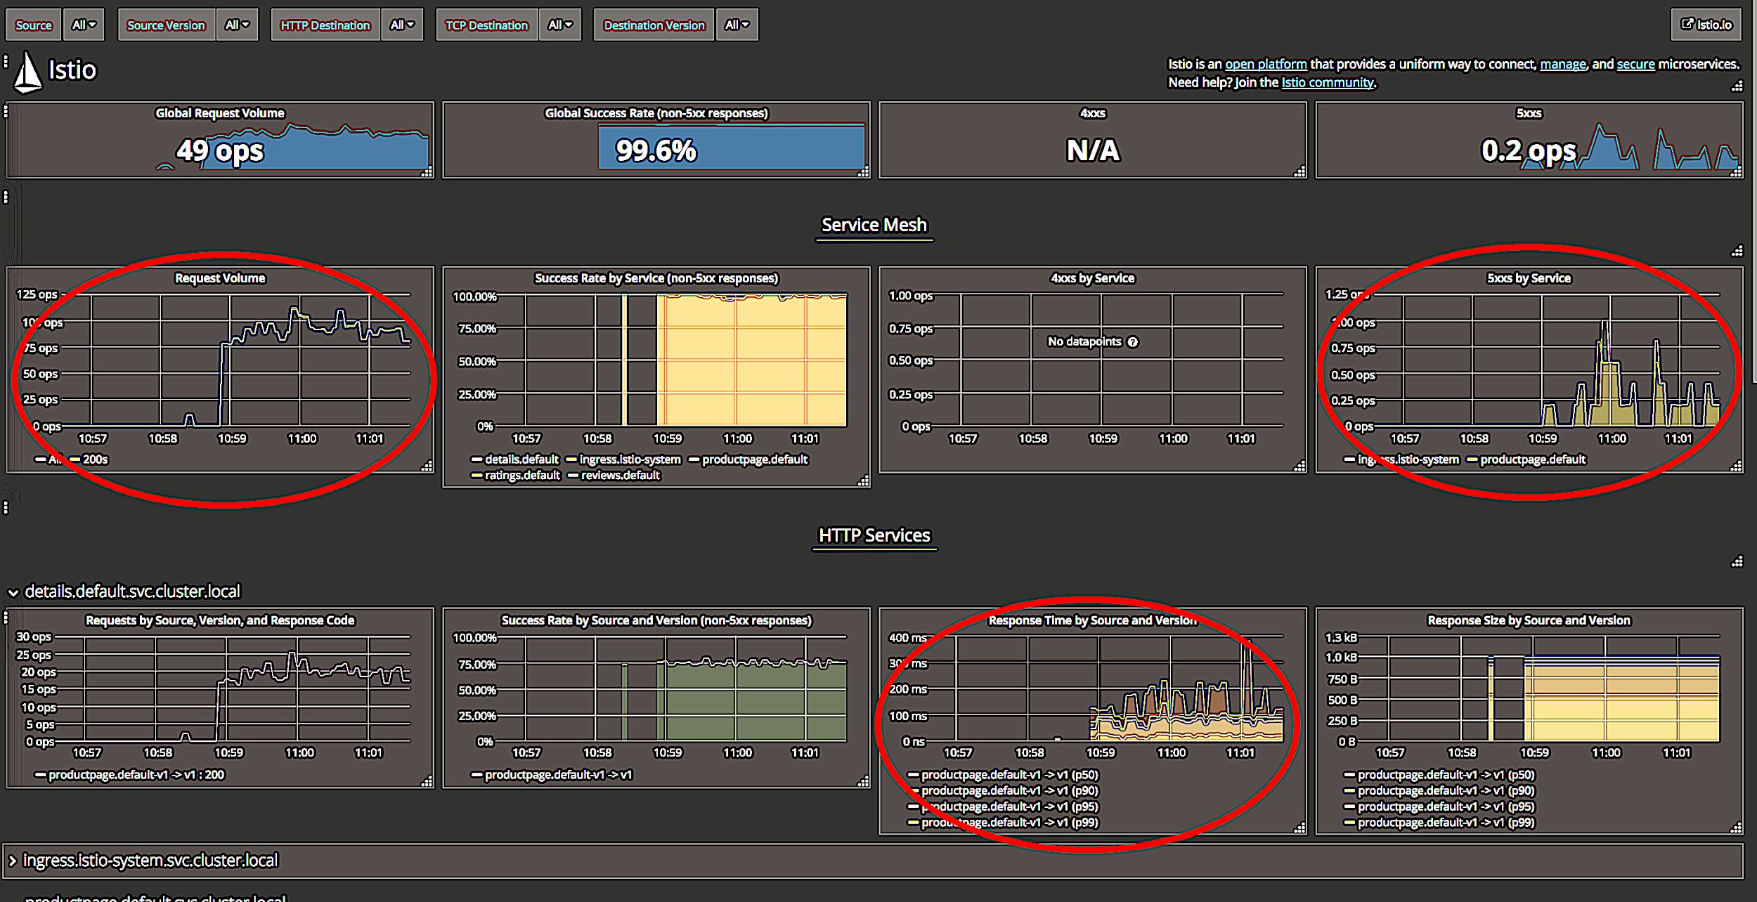
Istio Grafana Dashboard
@phredmoyer
Notes:
We have the request rate in operations per second in the upper left, the number of failed requests per second in the upper right, and a graph of response time in the bottom. There are several other indicators on this graph, but let’s take a closer look at the ones I’ve circled.

Slide 19
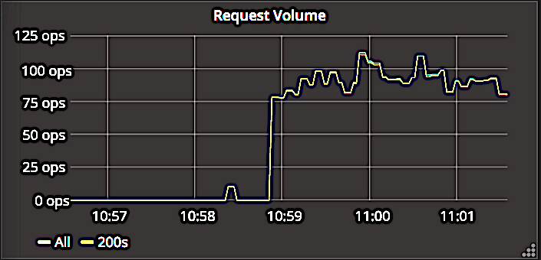
Rate
@phredmoyer
Notes:
Here’s the rate component of the dashboard, pretty straight forward. We count the number of requests which returned a 200 response code and graph the rate over time.

Slide 20
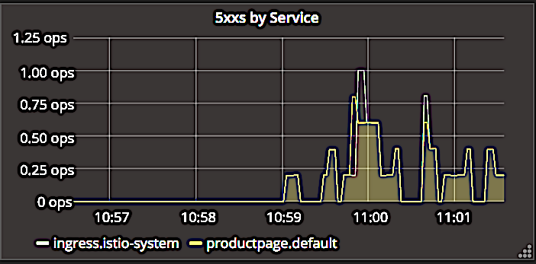
Errors
@phredmoyer
Notes:
The Istio dashboard does something similar for for responses that return a 5xx error code. You can see here how it breaks down the errors by either the ingress controller, or errors from the application product page itself.

Slide 21
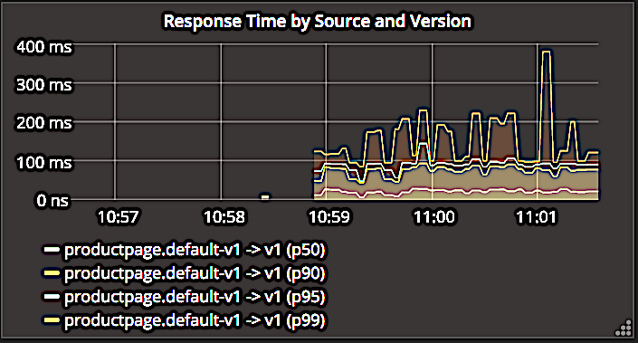
Duration
@phredmoyer
Notes:
Here’s the request duration graph, this is probably the most informative as to the health of our service. This data is provided by a prometheus monitoring system, so we see request time percentiles graphed here, the median, 90th, 95th, and 99th percentiles.
While these percentiles give us some overall indication of how the service is performing, there are a number of deficiencies with this approach that are worth examining.
For example, during times of low activity, these percentiles can skew wildly because of limited numbers of samples, and you can misinterpret the system performance in those situations. Let’s take a look at the other issues that can arise with this approach.

Slide 22
Talk Agenda
Istio Overview
Exercises
Istio Mixer Metrics Adapters
Exercises
Math and Statistics
Exercises
SLOs / RED Dashboards
@phredmoyer
Notes:
So just a quick overview of the the talk roadmap. I’ll first give an overview of Istio and why it is awesome, then I’ll do a brief refresher on service level objectives to set a baseline. We’ll look at what a Red dashboard is and how we can make it more awesome with histogram based telemetry. Then I’ll do a brief walkthrough of the Istio metrics adapter I wrote, and finish up with a couple examples of how we can ask the right questions of the services we are monitoring.

Slide 23
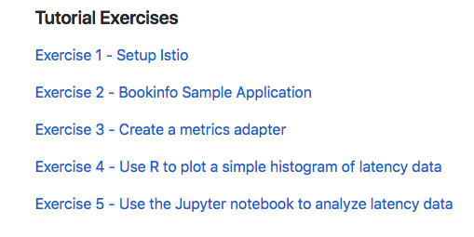
Setup Istio
https://github.com/redhotpenguin/oscon_2018
@phredmoyer

Slide 24
Bookinfo Sample Application
https://github.com/redhotpenguin/oscon_2018
@phredmoyer

Slide 25
Talk Agenda
Istio Overview
Exercises
Istio Mixer Metrics Adapters
Exercises
Math and Statistics
Exercises
SLOs / RED Dashboards
@phredmoyer

Slide 26
@phredmoyer
Notes:
We’ll take a short 5-10 minute intermission here so folks can stretch their legs, grab more coffee, or visit the restroom.

Slide 27
Istio Metrics Adapter
Golang based adapter API
Legacy - In process (built into the Mixer executable)
Current - Out of process for new adapter dev
Set of handler hooks and YAML files
@phredmoyer
Notes:
Istio provides developers with an adapter API that they can use to create their own custom adapters for telemetry syndication, as well as traffic management and policy enforcement.
Mixer is written in Golang, and provides a set of predefined handler endpoints that you can write a golang package to receive request and response metadata, and act on it. The development team is currently exploring an option for out of process mixer adapters using GRPC, but we’ll be looking at an in process implementation.
Along with Go code, mixer adapter developers also create a set of YAML files to tell the adapter what data to receive and what to do with it.

Slide 28
Istio Mixer Metric Adapter
@phredmoyer
Notes:
Let’s take a more in depth look at the Istio metrics adapters. These adapters allow telemetry that is captured during the request cycle to be syndicated. This diagram shows Istio’s in process metrics adapters.

Slide 29
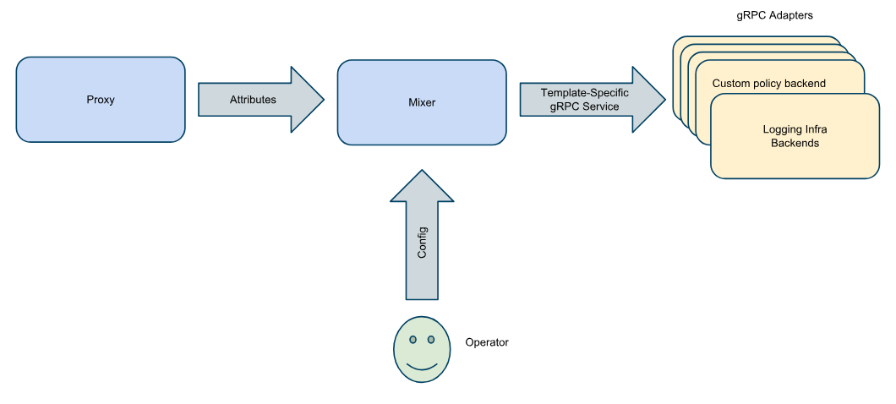
Out of Process gRPC Adapters
@phredmoyer
Notes:
Notice how in this diagram the adapters are separated from Mixer. This has a number of advantages; if an adapter crashes, it doesn’t take down mixer, and adapter development is loosely coupled to mixer development. There is a small amount of additional performance overhead with this design, but in practice it has not proven to be significant.
Out of process adapters are the future of Mixer adapter development; if you want to make an adapter, this is the approach you will want to use. The implementation is currently in Beta quality; currently there is only the Prometheus adapter which is out of process.

Slide 30
Containers?
Ephemeral
High Cardinality
Difficult to Instrument
Instrument Services, Not Containers
@phredmoyer
Notes:
But wait, the title of this talk mentioned containers. Why aren’t we looking at monitoring the containers? Containers are ephemeral, short lived entities, and monitoring them directly to discern our service health presents a number of complex problems, such as the dreaded high cardinality issue.
It is easier and more effective to monitor the service outputs of those containers in aggregate. We don’t care if one container is misbehaving if the service is healthy; chances are that our orchestration framework will reap that container anyway and replace it with a new one.

Slide 31
Istio Mixer Provided Telemetry
Request Count by Response Code
Request Duration
Request Size
Response Size
Connection Received Bytes
Connection Sent Bytes
Connection Duration
Template Based MetaData (Metric Tags)
@phredmoyer
Notes:
To compose our RED dashboard, let’s look at what telemetry is provided by Istio. I’ve given part of it away here with the font color. Istio provides several metrics about the requests it receives, the latency to generate a response, and connection level data.
It also gives us the ability to add metric tags, called dimensions in Istio, to this telemetry. So we can break down the telemetry by host, cluster, etc.

Slide 32
Metric Dimensions
HandleMetric invoked with: Adapter config: &Params{FilePath:out.txt,} Instances: 'i1metric.instance.istio-system': { Value = 1652 Dimensions = map[response_code:200] }
http://metrics20.org/
@phredmoyer
Notes:
Here’s an example of Dimensions in Istio Mixer metrics. They are basically a set of key value pairs. You’ll find them similar to what are called ‘metrics tags’. There’s an emerging standard called ‘Metrics 2.0’ which includes metrics tags; worth a read.

Slide 33
Istio Mixer Metrics Adapter
“SHOW ME THE CODE”
https://github.com/istio/istio/
https://github.com/istio/istio/blob/master/mixer/adapter/circonus
@phredmoyer
Notes:
So let’s dive right in a take a brief look at the code. I’ll give folks a few seconds to bring up the code repo on Microsoft, uh whoops I meant Github.

Slide 34
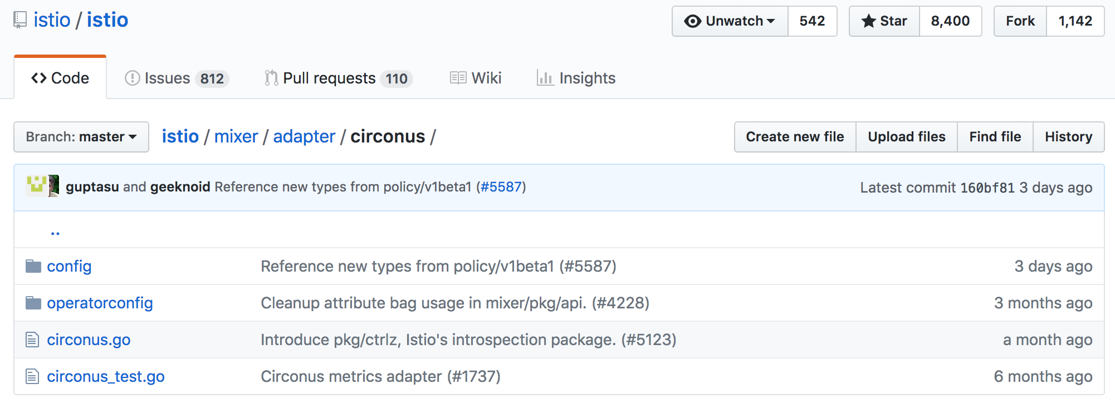
Istio Mixer Metrics Adapter
@phredmoyer
Notes:
Here’s the root level directory for the circonus adapter I created. The adapter code is in circonus.go, and the tests in circonus_test.go.
The config directory contains YAML configuration needed to tell Istio what telemetry to send to the adapter, and the operatorconfig directory gives a sample configuration file. You can cd up to the adapter directory also to see all of the other adapters that folks have created.

Slide 35
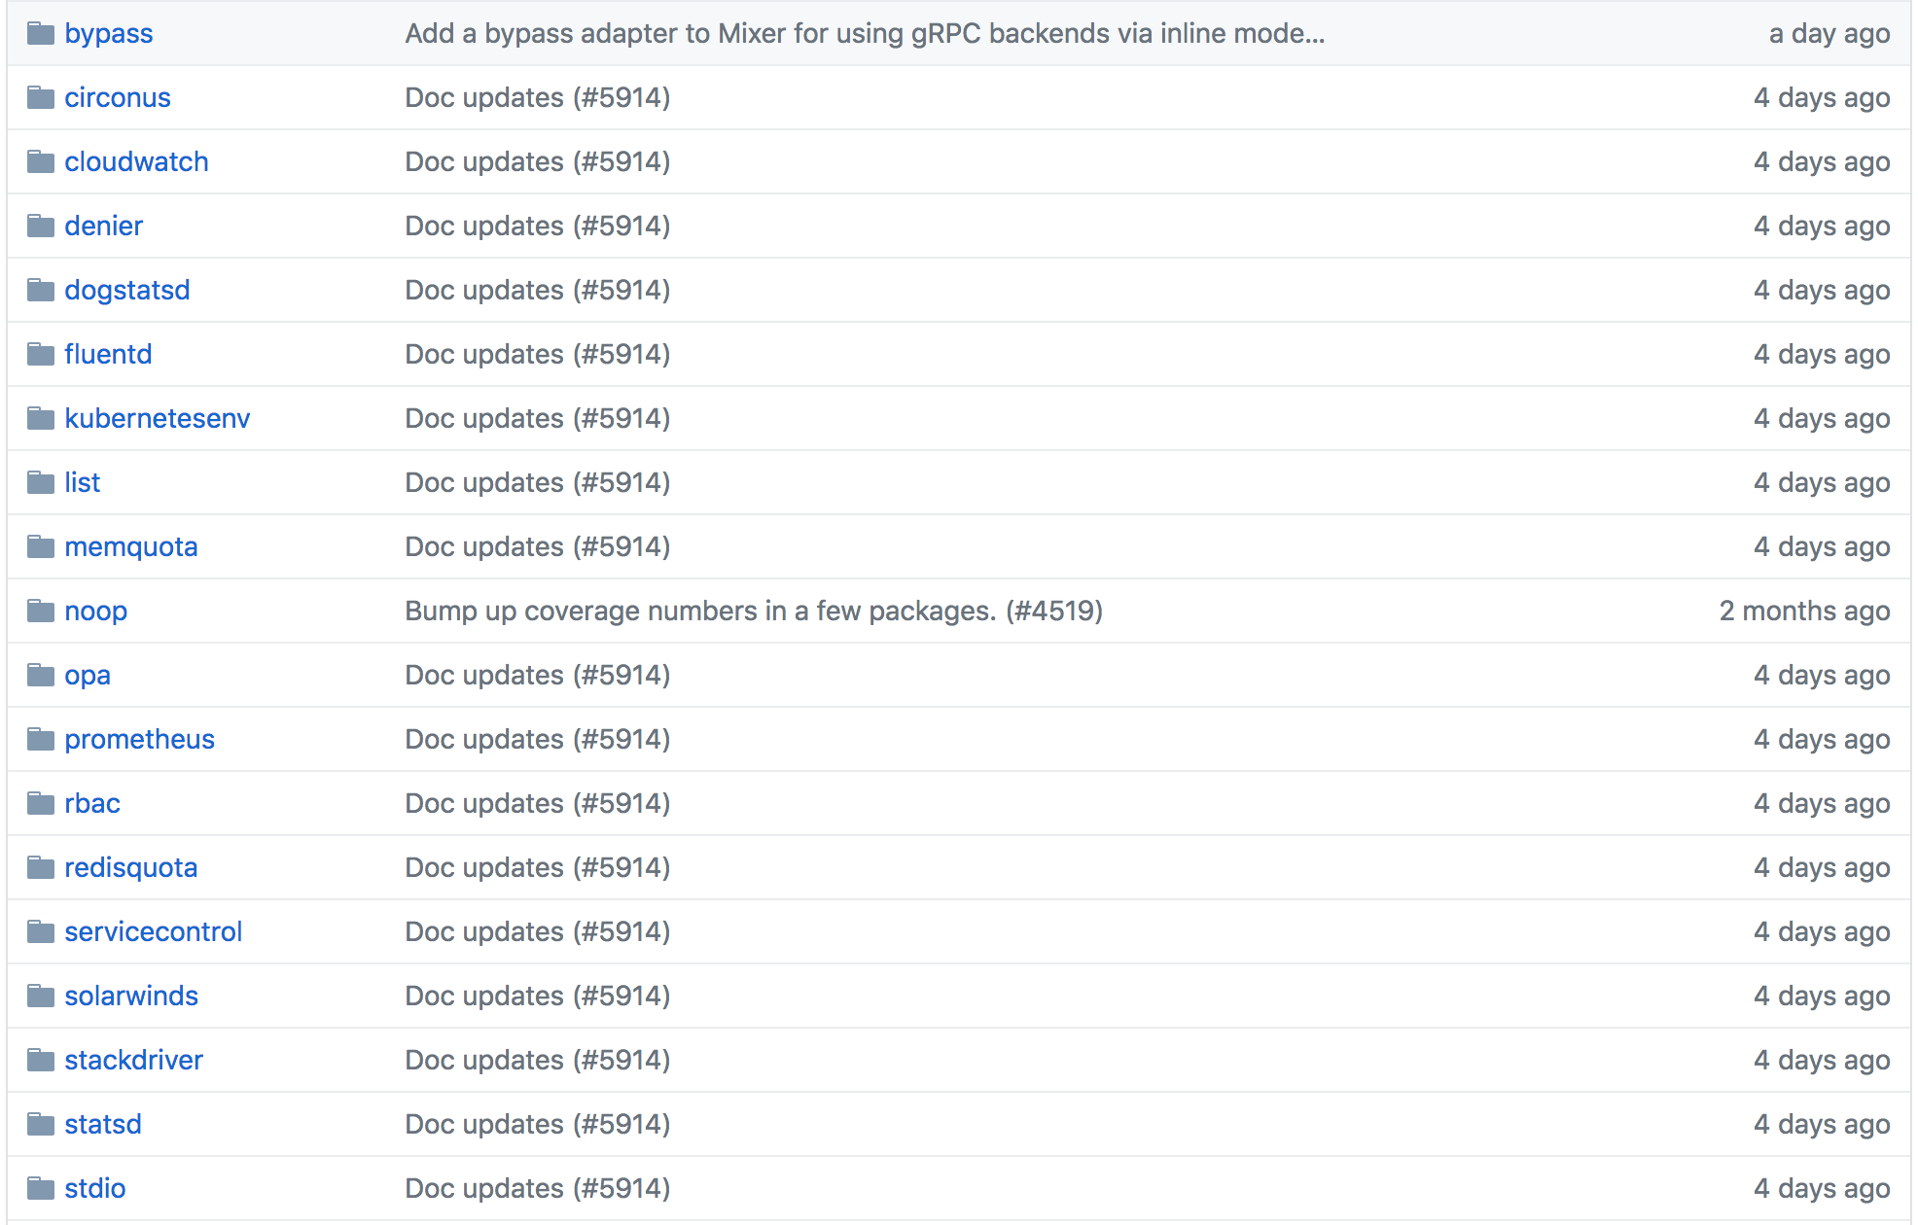
Istio Mixer Metrics Adapter
@phredmoyer
Notes:
Here’s a list of all of the adapters that Mixer has. There are also third party adapters for Cloudwatch, Datadog, Solarwinds, and Stackdriver.
It was fun to see more telemetry adapters get added after I finished the Circonus adapter and was able to pass along feedback to the Istio development team about what was fun about it and what wasn’t fun. Initially the Istio project was using the Bazel build system to build the Istio executable. I attended a few of the community meetings where folks were grumbling about some of its difficulties, and I was able to chime in with my experiences as an outside developer as well.

Slide 36
Istio Mixer Metrics Adapter
// HandleMetric submits metrics to Circonus via circonus-gometrics func (h *handler) HandleMetric(ctx context.Context, insts
[]*metric.Instance) error { for _, inst := range insts { metricName := inst.Name metricType := h.metrics[metricName] switch metricType { case config.GAUGE: value, _ := inst.Value.(int64) h.cm.Gauge(metricName, value) case config.COUNTER: h.cm.Increment(metricName)
@phredmoyer
Notes:
Here’s the meat of the adapter. The HandleMetric function takes a context object and a slice of metric instances. The handler object already contains an instantiation of the circonus-gometrics library which is the glue to interface with Circonus.
The logic here is pretty simple; we loop over each metric instance, and then tell circonus gometrics to log it as either a gauge, a counter (the request and error rate metrics), or a distribution.

Slide 37
Istio Mixer Metrics Adapter
case config.DISTRIBUTION: value, _ := inst.Value.(time.Duration) h.cm.Timing(metricName, float64(value)) } } return nil }
@phredmoyer
Notes:
I’ve highlighted both the counter and distribution cases in red, since that’s where we are recording the telemetry needed for our RED dashboard. The log-linear histogram implementation is abstracted by circonus-gometrics, so when we record a distribution metric, it adds that value to an existing histogram data structure.
If this all looks pretty simple, that’s because most of the work is abstracted into the circonus client.

Slide 38
Istio Mixer Metrics Adapter
handler struct { cm *cgm.CirconusMetrics env adapter.Env metrics map[string]config.Params_MetricInfo_Type cancel context.CancelFunc }
@phredmoyer
Notes:
The handler object shown in the previous slide is a struct composed of the circonus-gometrics client adapter, an environment struct, a metrics config map, and a context cancel function.
The environment element encapsulates some common functionality such as logging, an interface to a job scheduling daemon, and some other mixer utilities.
The metrics map contains a map of the metrics that we configured in a yaml file as available, to the list provided by Mixer.
The cancel struct member contains a context cancel function. This is a really cool feature of Go; it allows us to setup a context that is available to other callbacks. So when Istio shuts down, we can call handler.cancel, and it triggers a metrics flush and any needed destructors.

Slide 39
And some YAML
metrics: - name: requestcount.metric.istio-system type: COUNTER - name: requestduration.metric.istio-system type: DISTRIBUTION - name: requestsize.metric.istio-system type: GAUGE - name: responsesize.metric.istio-system type: GAUGE
@phredmoyer
Notes:
Here we write some YAMl to tell Istio which metrics to map to what metric type.
We map request count (along with the request metadata) to a counter type.
We map request distribution to a distribution type.
We map both the request size and the response size to gauge data types.

Slide 40
Buffer metrics, then report
env.ScheduleDaemon( func() { ticker := time.NewTicker(b.adpCfg.SubmissionInterval) for { select { case <-ticker.C: cm.Flush() case <-adapterContext.Done(): ticker.Stop() cm.Flush() return } } })
@phredmoyer
Notes:
Because Istio is designed to run at high QPS rates, we don’t syndicate metrics for each request. We tell Istio to run a daemon which flushes the circonus client at regular intervals, and also when Istio shuts down.
Writing an Istio adapter is fairly straightforward. I’m giving a tutorial on it at OSCON in Portland in July. I’m happy to walk through the code in depth here also with anyone who is interested.

Slide 41
Talk Agenda
Istio Overview
Exercises
Istio Mixer Metrics Adapters
Exercises
Math and Statistics
Exercises
SLOs / RED Dashboards
@phredmoyer
Notes:
So just a quick overview of the the talk roadmap. I’ll first give an overview of Istio and why it is awesome, then I’ll do a brief refresher on service level objectives to set a baseline. We’ll look at what a Red dashboard is and how we can make it more awesome with histogram based telemetry. Then I’ll do a brief walkthrough of the Istio metrics adapter I wrote, and finish up with a couple examples of how we can ask the right questions of the services we are monitoring.

Slide 42
Create a metrics adapter
https://github.com/redhotpenguin/oscon_2018
@phredmoyer

Slide 43
Talk Agenda
Istio Overview
Exercises
Istio Mixer Metrics Adapters
Exercises
Math and Statistics
Exercises
SLOs / RED Dashboards
@phredmoyer
Notes:
So just a quick overview of the the talk roadmap. I’ll first give an overview of Istio and why it is awesome, then I’ll do a brief refresher on service level objectives to set a baseline. We’ll look at what a Red dashboard is and how we can make it more awesome with histogram based telemetry. Then I’ll do a brief walkthrough of the Istio metrics adapter I wrote, and finish up with a couple examples of how we can ask the right questions of the services we are monitoring.

Slide 44
@phredmoyer
Notes:
We’ll take a short 5-10 minute intermission here so folks can stretch their legs, grab more coffee, or visit the restroom.

Slide 45
MATH
https://youtu.be/yCX1Ze3OcKo
@phredmoyer
Notes:
I believe that we can do better than this, and the next part of the talk will focus on how we can use math to generate the service level indicators that we need to give us a comprehensive view of our service’s performance and health.
Has anyone here seen the donald duck math video? Maybe I’m showing my age, we watched this in grade school.
So let’s push on and have some fun with math.

Slide 46
Histogram Basics
Mode
q(0.9)
Median q(0.5)
Number of Samples
q(1)
Mean
Sample Value
@phredmoyer
Notes:
So just a quick overview of the the talk roadmap. I’ll first give an overview of Istio and why it is awesome, then I’ll do a brief refresher on service level objectives to set a baseline. We’ll look at what a Red dashboard is and how we can make it more awesome with histogram based telemetry. Then I’ll do a brief walkthrough of the Istio metrics adapter I wrote, and finish up with a couple examples of how we can ask the right questions of the services we are monitoring.

Slide 47
Histogram
https://github.com/circonus-labs/circonusllhist
@phredmoyer
Notes:
This is a visualization of latency data for a service in microseconds using a histogram. The number of samples is on the Y-Axis, and the sample value, in this case microsecond latency, is on the X-Axis.
This is the open source histogram we developed at Circonus. There are a few other histogram implementations out there that are open source, such as Ted Dunning’s t-digest histogram and the HDR histogram.
The Envoy project recently implemented the C implementation of this log linear histogram library to collect envoy telemetry as distributions. They actually found a very minor bug in implementation. We were quite happy to fix it. That’s the beauty of open source, the more eyes on the code, the better it gets over time.
Histograms have a property of mergeability; I can take this distribution, and combine it with other distribution as long as the bin boundaries are identical.
Mergeable metrics are awesome for monitoring and observability, as they allow us to combine outputs from similar sources such as service members, and calculate aggregates to obtain aggregate service metrics.

Slide 48
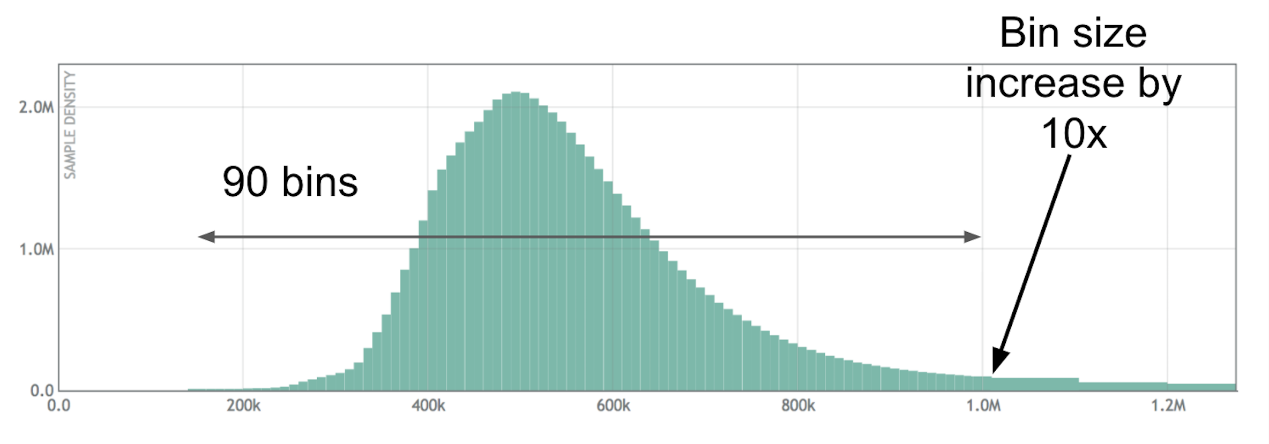
Log linear histogram
https://github.com/circonus-labs/circonusllhist
@phredmoyer
Notes:
This log linear histogram contains 90 bins for each power of 10. You can see 90 bins between 100,000 and 1M. At each power of 10, the bin size increases by a factor of 10. This allows us to record a wide range of values with high relative accuracy without needing to know the data distribution ahead of time.

Slide 49
Log linear histogram
https://github.com/circonus-labs/circonusllhist
@phredmoyer
Notes:
Here you can see where we have overlayed the average, and the 50th percentile (also known as the median), and the 90th percentile. The 90th percentile is the value at which 90% of the samples are below that value.

Slide 50
Bi-modal Histogram
@phredmoyer
Notes:
This histogram shows a distribution with two distinct modes. The leftmost mode could be fast responses due to serving from a cache, and the right mode from serving from disk. Just measuring latency using four percentiles would make it nearly impossible to discern a distribution like this. This gives us a sense of the complexity that percentiles can mask.
What if we had more than two modes?

Slide 51
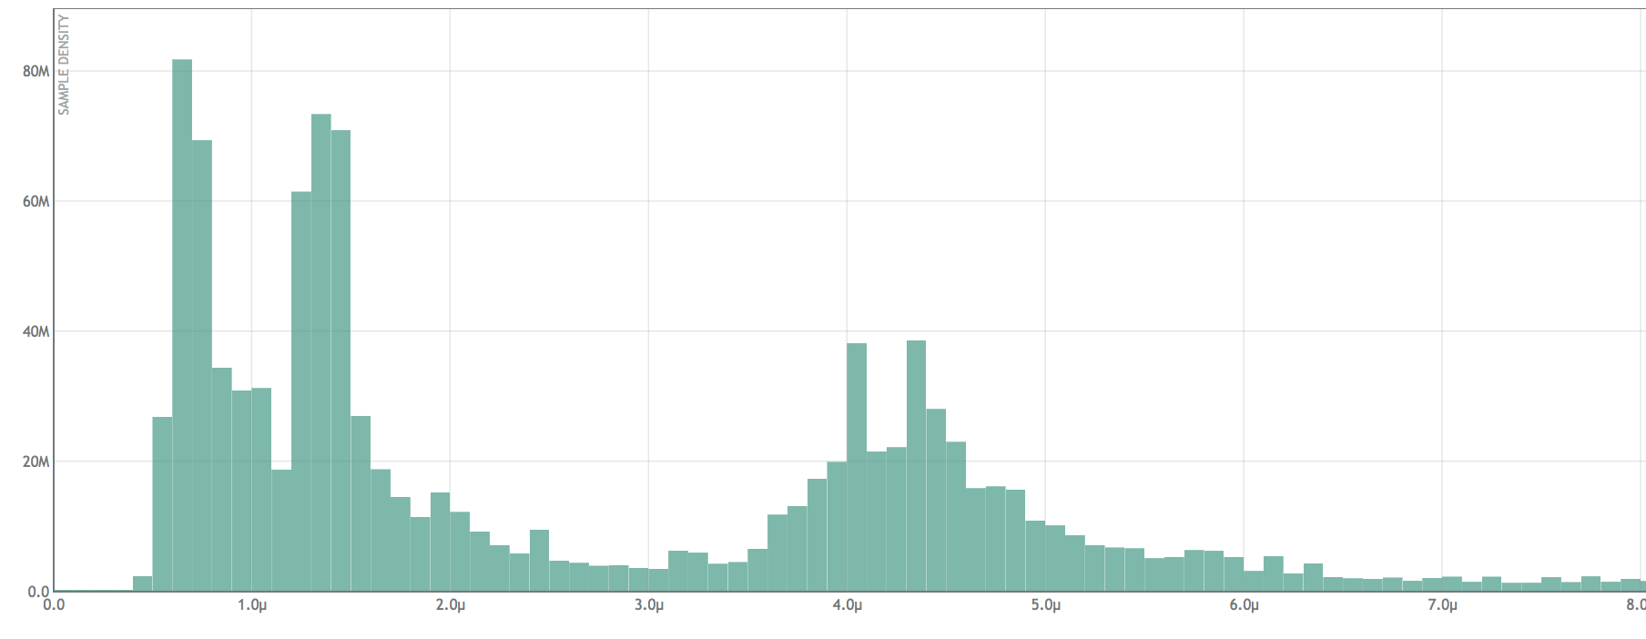
Multi-modal Histogram
@phredmoyer
Notes:
This distribution has at least four visible modes. If we do the math on the full distribution, we will actually find 20+ modes here. How many percentiles would you need to record to approximate a latency distribution like this?

Slide 52
Multi-modal Histogram
@phredmoyer
Notes:
How about a distribution like this? Complex systems composed of many service will generate latency distributions that simply cannot be accurately represented by using percentiles; you have to record the entire latency distribution to be able to fully represent it.
This type of histogram visualization shows a distribution over a fixed time window. We can store multiple distributions to get a sense of how it changes over time.

Slide 53
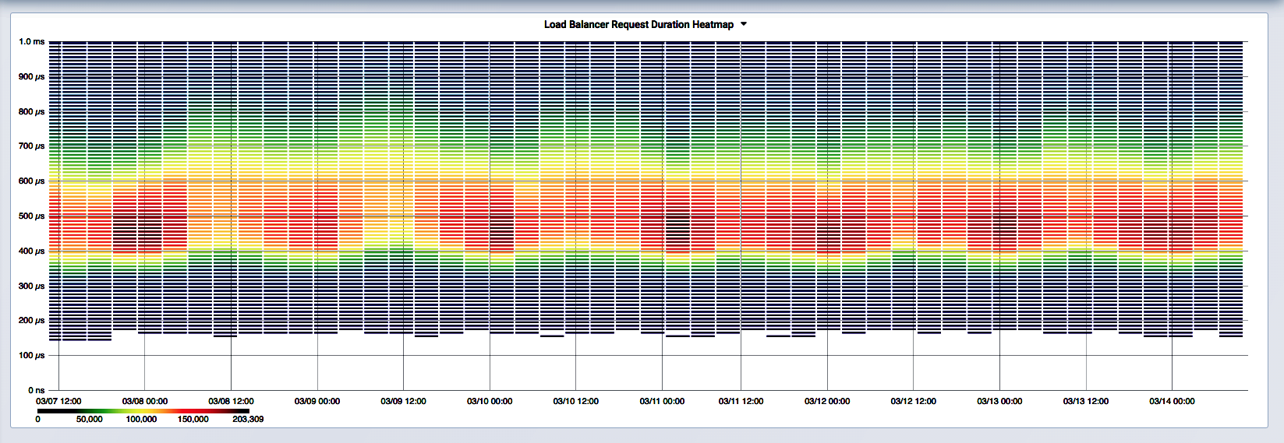
Heatmap - Time Series Histograms
@phredmoyer
Notes:
This is a heatmap, a set of histograms over time. This is a grafana visualization of the response latency from a cluster of 10 load balancers. This gives us a deep insight into the system behavior of the entire cluster over a week, there’s over 1 million data samples here. The median here centers around 500 microseconds, shown in the red colored bands.

Slide 54
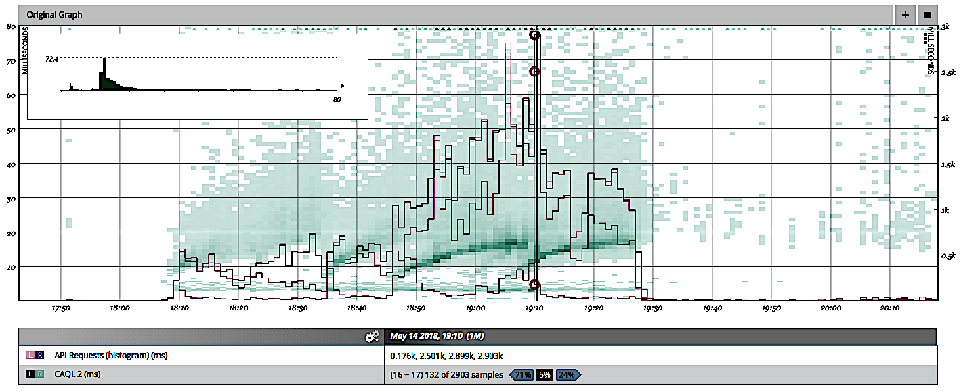
Heatmap - Time Series Histograms
@phredmoyer
Notes:
This is another type of heatmap. You can see where we’ve overlayed percentile calculations over time on top of the heatmap. Percentiles are robust metrics and very useful, but not alone by themselves. We can see here how the 90+ percentiles increase as the latency distribution shifts upwards.
Let’s take these distribution based duration maps and see if we can generate something more informative than the Istio dashboard.

Slide 55
Quantile Calculation
Given a quantile q(X) where 0 < X < 1
Sum up the counts of all the bins, C
Multiply X * C to get count Q
Walk bins, sum bin boundary counts until > Q
Interpolate quantile value q(X) from bin
@phredmoyer
Notes:
Let’s talk about performing quantile calculations. The quantile notation q of X is just a fancy way of specifying a percentile. The 90th percentile would be q of 0.9, the 95th would be q of 0.95, and the maximum would be q of 1.
So say we wanted to calculate the median, q of 0.5. First we iterate over the histogram and sum up the counts in all of the bins. Remember that cumulative histogram we talked about earlier? Guess what - the far right bin already contains the total count, so if you are using a cumulative histogram variation, that part is already done for you and can be a small optimization for quantile calculation since you have an O(1) operation instead of O(n)
Now we multiple that count by the quantile value. If we say our count is 1,000 and our median is 0.5, we get a Q of 500.
Next iterate over the bins, summing the left and right bin boundary counts, until Q is between those counts. If the count Q matches the left bin boundary count, our quantile value is that bin boundary value. If Q falls in between the left and right boundary counts, we use linear interpolation to calculate the sample value.

Slide 56
Linear Interpolation
right_count=800
bin_count=200
left_count=600
q(X) = left_value+(Q-left_count) /
(right_count-left_count)*bin_width
Q = 700
X = 0.5
q(X) = 1.05
q(X) = 1.0+(700-600) /
(800-600)*0.1
left_value=1.0
right_value=1.1
@phredmoyer
Notes:
Let’s go over the linear interpolation part of quantile calculation. Once we have walked the bins to where Q is located in a certain bin, we use the formula shown here.
Little q of X is the left bin value plus big Q minus the left bin boundary, divided by the count differences of the left and ride sides of the bin, times the bin width.
Using this approach we can determine the quantile for a log linear histogram to a high degree of accuracy.
In terms of what error levels we can experience in terms of quantile calculation, with one sample in a bin it is possible to see a worst case 5% error if the value is 109.9 in a bin bounding 100-110; the reported value would be 105. The best case error for one sample is 0.5% for a value of 955 in a bin spanning 950-960.
However, our use of histograms is geared towards very large sets of data. With bins that contain dozens, hundreds, or more samples, accuracy should be expected to 3 or 4 nines.

Slide 57
Inverse Quantiles
What’s the 95th percentile latency?
q(0.95) = 10ms
What percent of requests exceeded 10ms?
5% for this data set; what about others?
@phredmoyer
Notes:
We can also use histograms to calculate inverse quantiles. Humans can reason about thresholds more naturally than they can about quantiles.
If my web service gets a surge in requests, and my 99th percentile response time doesn’t change, that not only means that I just got a bunch of angry users whose requests took too long, but even worse I don’t know by how much those requests exceeded that percentile. I don’t know how bad the bleeding is.
Inverse quantiles allow me to set a threshold sample value, then calculate what percentage of values exceeded it.

Slide 58
Inverse Quantile Calculation
Given a sample value X, locate its bin
Using the previous linear interpolation equation, solve for Q given X
@phredmoyer
Notes:
To calculate the inverse quantile, we start with the target sample and work backwards towards the target count Q

Slide 59
Inverse Quantile Calculation
X = left_value+(Q-left_count) / (right_count-left_count)*bin_width
X-left_value = (Q-left_count) / (right_count-left_count)*bin_width
(X-left_value)/bin_width = (Q-left_count)/(right_count-left_count)
(X-left_value)/bin_width*(right_count-left_count) = Q-left_count
Q = (X-left_value)/bin_width*(right_count-left_count)+left_count
@phredmoyer
Notes:
Given the previous equation we had, we can use some middle school level algebra (well, it was when I was in school) and solve for Q

Slide 60
Linear Interpolation
left_count=600
right_count=800
Q =(X-left_value)/bin_width *
(right_count-left_count)+left_count
Q = (1.05-1.0)/0.1*(800-600)+600
X = 1.05
Q = 700
left_value=1.0
right_value=1.1
@phredmoyer
Notes:
Solving for Q, we get 700, which is expected for our value of 1.05.

Slide 61
Inverse Quantile Calculation
Given a sample value X, locate its bin
Using the previous linear interpolation equation, solve for Q given X
Sum the bin counts up to Q as Q_{left}
Inverse quantile q_{inv}(X) = (Q_{total}-Q_{left})/Q_{total}
For Q_{left}=700, Q_{total} = 1,000, q_{inv}(X) = 0.3
30% of sample values exceeded X
@phredmoyer
Notes:
Now that we know Q, we can add up the counts to the left of it, subtract that from the total and then divide by the total to get the percentage of sample values which exceeded our sample value X.
So if we are running a website, and we know from industry research that we’ll lose users if our requests take longer than three seconds, we can set X at 3 seconds, calculate the inverse quantile for our request times, and figure out what percentages of our users are getting mad at us. Let’s take a look at how we have been doing that in real time with Circonus.

Slide 62
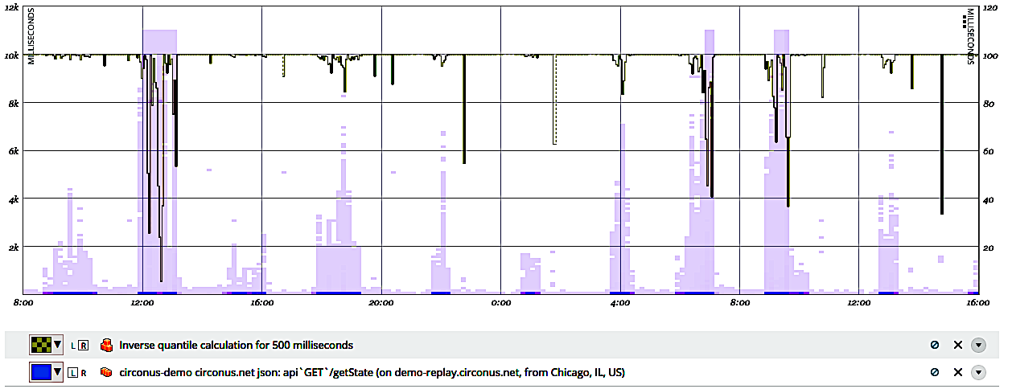
Inverse Quantile Calculation
@phredmoyer
Notes:
We can calculate inverse quantiles with a set threshold over windowed histograms, and plot that on a heatmap. Here we can see what percentage of requests were within our 500 millisecond threshold.

Slide 63
Talk Agenda
Istio Overview
Exercises
Istio Mixer Metrics Adapters
Exercises
Math and Statistics
Exercises
SLOs / RED Dashboards
@phredmoyer
Notes:
So just a quick overview of the the talk roadmap. I’ll first give an overview of Istio and why it is awesome, then I’ll do a brief refresher on service level objectives to set a baseline. We’ll look at what a Red dashboard is and how we can make it more awesome with histogram based telemetry. Then I’ll do a brief walkthrough of the Istio metrics adapter I wrote, and finish up with a couple examples of how we can ask the right questions of the services we are monitoring.

Slide 64
Create a metrics adapter
https://github.com/redhotpenguin/oscon_2018
@phredmoyer

Slide 65
Create a metrics adapter
https://github.com/redhotpenguin/oscon_2018
@phredmoyer

Slide 66
Talk Agenda
Istio Overview
Exercises
Istio Mixer Metrics Adapters
Exercises
Math and Statistics
Exercises
SLOs / RED Dashboards
@phredmoyer
Notes:
So just a quick overview of the the talk roadmap. I’ll first give an overview of Istio and why it is awesome, then I’ll do a brief refresher on service level objectives to set a baseline. We’ll look at what a Red dashboard is and how we can make it more awesome with histogram based telemetry. Then I’ll do a brief walkthrough of the Istio metrics adapter I wrote, and finish up with a couple examples of how we can ask the right questions of the services we are monitoring.

Slide 67
Service Level Objectives
SLI - Service Level Indicator
SLO - Service Level Objective
SLA - Service Level Agreement
@phredmoyer
Notes:
Most people here are probably familiar with the Google SRE book. The concept of SLAs has been around for at least a decade, but service level objectives and service level indicators are also becoming ubiquitous amongst site reliability engineers. The amount of online content around these terms has been increasing rapidly. I have had to restructure this talk over the past few weeks to include some of the most recent content.

Slide 68
Service Level Objectives
@phredmoyer
Notes:
In addition to the Google SRE book, two new books that talk about service level objectives are due for publication soon. The site reliability workbook has a dedicated chapter on service level objectives. Seeking SRE has a chapter on defining SLOs by Theo Schlossnagle, the Circonus CEO (shout out there as they are paying for my trip here).

Slide 69
“SLIs drive SLOs which inform SLAs”
SLI - Service Level Indicator, a measure of the service that can be quantified
“95th percentile latency of homepage requests over past 5 minutes < 300ms”
Excerpted from
“SLIs, SLOs, SLAs, oh my!” @sethvargo @lizthegrey
https://youtu.be/tEylFyxbDLE
@phredmoyer
Notes:
I’m pulling in a few excerpts from a great youtube video by Seth Vargo and Liz Fong Jones I recently watched which I think explains these concepts really well. I recommend watching the video to get an in depth understanding.
The gist of that video is that SLIs drive SLOs which inform SLAs.
A service level indicator is basically a metric derived measure of health for a service. For example, I could have an SLI that says my 95th percentile latency of homepage requests over the last 5 minutes should be less than 300 milliseconds.

Slide 70
“SLIs drive SLOs which inform SLAs”
SLO - Service Level Objective, a target for Service Level Indicators
“95th percentile homepage SLI will succeed 99.9% over trailing year”
Excerpted from
“SLIs, SLOs, SLAs, oh my!” @sethvargo @lizthegrey
https://youtu.be/tEylFyxbDLE
@phredmoyer
Notes:
A service level objective is basically how we take a service level indicator, and extend the scope of it to quantify how we expect our service to perform over a strategic time interval. Drawing on the SLI we talked about in the previous, we could say that we want to meet the criteria set by that SLI for three nines over a trailing year window.

Slide 71
“SLIs drive SLOs which inform SLAs”
SLA - Service Level Agreement, a legal agreement between a customer and a service provider based on SLOs
“Service credits if 95th percentile homepage SLI succeeds less than 99.5% over trailing year”
Excerpted from
“SLIs, SLOs, SLAs, oh my!” @sethvargo @lizthegrey
https://youtu.be/tEylFyxbDLE
@phredmoyer
Notes:
Service level agreements have been around for a long time. They are generally crafted by lawyers to limit the possibility of having to give customers money for those times when our service doesn’t perform like we committed to. SLAs are similar to SLOs, but the commitment level is relaxed, as we want our internal facing targets to be more strict than our external facing targets.

Slide 72
Log linear histogram
SLI - “90th percentile latency of requests over past 5 minutes < 1,000ms”
@phredmoyer
Notes:
Let’s bring up the SLI we talked about earlier. With latency data displayed in this format, we can easily calculate our SLI for a service by merging histograms together to get a 5 minute view of data, and then calculating the 90th percentile value for that distribution. If it is less than 1,000 milliseconds, we met our SLI.
Previously we showed the RED dashboard duration graph with four percentiles, the 50th, 90th, 95th, and 99th. We can overlay those percentiles on this distribution, and likely get a coarse guess of what request distribution might be without the data, but as you can see we would be making a lot of assumptions. What about if the distribution had additional modes?

Slide 73
Emerging Standards
USE
Utilization, Saturation, Errors
Introduced by Brendan Gregg @brendangregg
KPIs for host based health
The Four Golden Signals
Latency, Traffic, Errors, Saturation
Covered in the Google SRE Book
Extended version of RED
RED
Rate, Errors, Duration
Introduced by Tom Wilkie @tom_wilkie
KPIs for API based health, SLI focused
@phredmoyer
Notes:
Over the past several years there have been a number of emerging standards regarding combinations of indicators for quantifying both host and service health.
Brendan Gregg introduced the USE method, which seeks to quantify health of a system host based on utilization, saturation, and errors metrics. For something like a CPU, we can use common utilization metrics for user, system, and idle percentages, and load average and run queue for saturation. The UNIX perf profiler is a good tool for measuring CPU error events.
The Google SRE book talks about using latency, traffic, errors, and saturation metrics. It is targeted at service health, and is similar to the RED method below, but extends it with saturation. In practice, it can be difficult to quantify service saturation.
Tom Wilkie introduced the RED method a few years ago. I talked to him about it in March, and he said it was something he just came up with and didn’t expect it to take off. With RED we monitor request rate, request errors, and request duration. Service Level Indicators can be integrated as part of a RED dashboard, as we’ll see in a bit.
But wait, the title of this talk mentioned containers. Why aren’t we looking at monitoring the containers? Containers are ephemeral, short lived entities, and monitoring them directly to discern our service health presents a number of complex problems, such as the dreaded high cardinality issue.
It is easier and more effective to monitor the service outputs of those containers in aggregate. We don’t care if one container is misbehaving if the service is healthy; chances are that our orchestration framework will reap that container anyway and replace it with a new one.

Slide 74
RED
Rate
Requests per second
First derivative of request count provided by Istio
Errors
Unsuccessful requests per second
First derivative of failed request count provided by Istio
Duration
Request latency provided by Istio
@phredmoyer
Notes:
So Istio provides us with the component metrics we need to construct a RED dashboard. We can get the rate in requests per second by taking the first derivative of the request count.
We can get the error rate by taking the derivative of the request count of unsuccessful requests.
And Istio provides us with the request latency of each request, so we can record how long each service request took to complete.
These three key metrics provide us with the building blocks to construct a fairly complete view of the health of a service.

Slide 75
Duration
Problems:
Percentiles > averages, but have limitations
Aggregated metric, fixed time window
Cannot be re-aggregated for cluster health
Cannot be averaged (common mistake)
Stored aggregates are outputs, not inputs
Difficult to measure cluster SLIs
Leave a lot to be desired for
@phredmoyer
Notes:
Percentiles are generally metrics than averages as you are expressing the range of values with multiple datapoints instead of just one. However, like an average, percentiles are an aggregated metric, calculated over a fixed time window for a fixed data set. If we calculate a duration percentile for one cluster member, we cannot merge that with another cluster member to get an aggregate performance metric for the whole cluster.
It is a common misconception that percentiles can be averaged; they cannot, except in rare cases where the distributions that generated them are nearly identical. If you only have the percentile, and not the source data, you cannot know that might be the case. It is a chicken and egg problem.
This also means that you cannot set service level indicators for an entire service due to the lack of mergeability, if you are measuring percentile based performance only for individual cluster members.
Our ability to set meaningful Service Level Indicators (and as a result SLOs) here is limited due to only having four latency data points over fixed time windows. So when you are working with percentile based duration metrics, you have to ask yourself, are my SLIs really good SLIs?

Slide 76
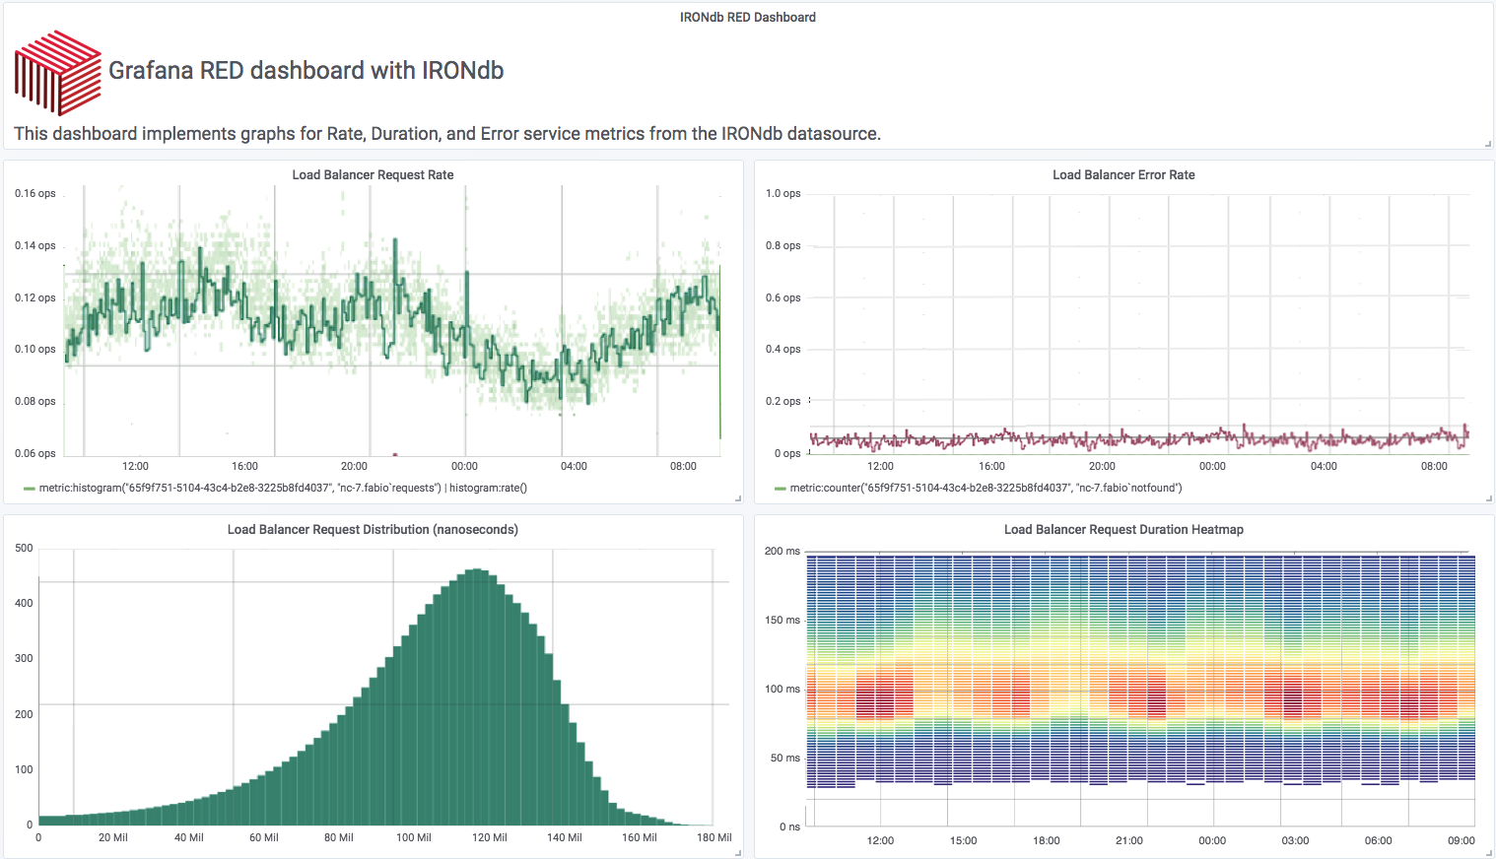
RED
@phredmoyer
Notes:
This is a RED dashboard revised to show distribution based latency data. Here in the lower left we show a histogram of latencies over a fixed time window. And to the right of it, we use a heat map to break that distribution down into smaller time windows.
With this layout of RED dashboard, we can get a complete view of how our service is behaving with only a few panels of information. This particular dashboard was implemented using Grafana served from an IRONdb time series database which stores the latency data natively as log linear histograms.

Slide 77
RED - SLI Alerting
@phredmoyer
Notes:
We can extend this RED dashboard a bit further and overlay our service level indicators onto the graphs as well.
For the rate panel, our SLI might be to maintain a minimum level of requests per second.
For the rate panel, our SLI might be to stay under a certain number of errors per second.
And as we have previously examined duration SLIs, we might want our 99th percentile for our entire service which is composed of several pods, to stay under a certain latency over a fixed window.
Using Istio telemetry stored as histograms enables us to set these meaningful service wide SLIs. Now we have a lot more to work with and as we’ll see in a bit, to ask questions of.

Slide 78
Your boss wants to know
How many users got angry on the Tuesday slowdown after the big marketing promotion?
Are we over-provisioned or under-provisioned on our purchasing checkout service?
Other business centric questions
@phredmoyer
Notes:
We all love being able to solve technical problems, but not everyone has that same focus. The folks on the business side want to answer questions on how the business is doing.
Let’s take the toolset we’ve assembled over the past 50 slides and align the capabilities with a couple of questions that folks here will likely be asked as SREs.

Slide 79
The Slowdown
Marketing launched a new product
Users complained the site was slow
Median human reaction time is 215 ms [1]
If users get angry (rage clicks) when requests take more than 500 ms, how many users got angry?
[1] - https://www.humanbenchmark.com/tests/reactiontime/
@phredmoyer
Notes:
First, the big slowdown. Everyone has been through this.
Marketing does a big push, and users complained the site got slow. How can we quantify the extent of how slow it was for everyone? How many users got angry? Marketing wants to know this so that they can send out a 10% discount email to the users affected (but hopefully not create a recurrence of the same problem).
Let’s craft an SLI and assume that users got angry if requests took more than 500 milliseconds.

Slide 80
The Slowdown
Record all service request latencies as distribution
Plot as a heatmap
Calculate percentage of requests that exceed 500ms SLI using inverse percentiles
Multiply result by total number requests, integrate over time
@phredmoyer
Notes:
How can we calculate how many users got angry with this SLI of 500 ms?
First (well, we should have already done this) is to record the request latencies as a distribution.
Then we can plot them as a heatmap.
We can use the distribution data to calculate the percentage of requests that exceeded our 500ms SLI by using inverse percentiles.
We take that answer, multiply it by the total number of requests in that time window, and integrate over time.

Slide 81
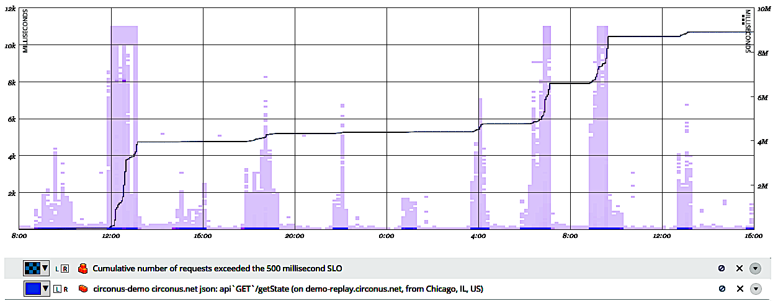
The Slowdown
4 million slow requests
@phredmoyer
Notes:
Then we can plot the result overlayed on the heatmap. I circled the slowdown part of the heatmap - the increased latency distribution is fairly indicative of a slowdown. The line on the graph indicates the total number of requests affected over time.
We managed to miss our SLI for 4 million requests. Whoops.
What isn’t obvious are the two additional slowdowns on the right because they are smaller in magnitude. Each of those cost us an additional 2 million SLI violations. Whoops.
We can do these kinds of mathematical analyses because we are storing data as distributions, not aggregations like percentiles.

Slide 82
Under or Over Provisioned?
“It depends”
Time of day, day of week
Special events
Behavior under load
Latency bands shed some light
@phredmoyer
Notes:
Here’s another common question. Is my service under provisioned, or over provisioned.
The answer is often, it depends. Loads vary from time of day and day of week, in addition to special events. Not to mention how the system behaves under load.
Let’s put some math to work and use things called latency bands to visualize how our system can perform.

Slide 83
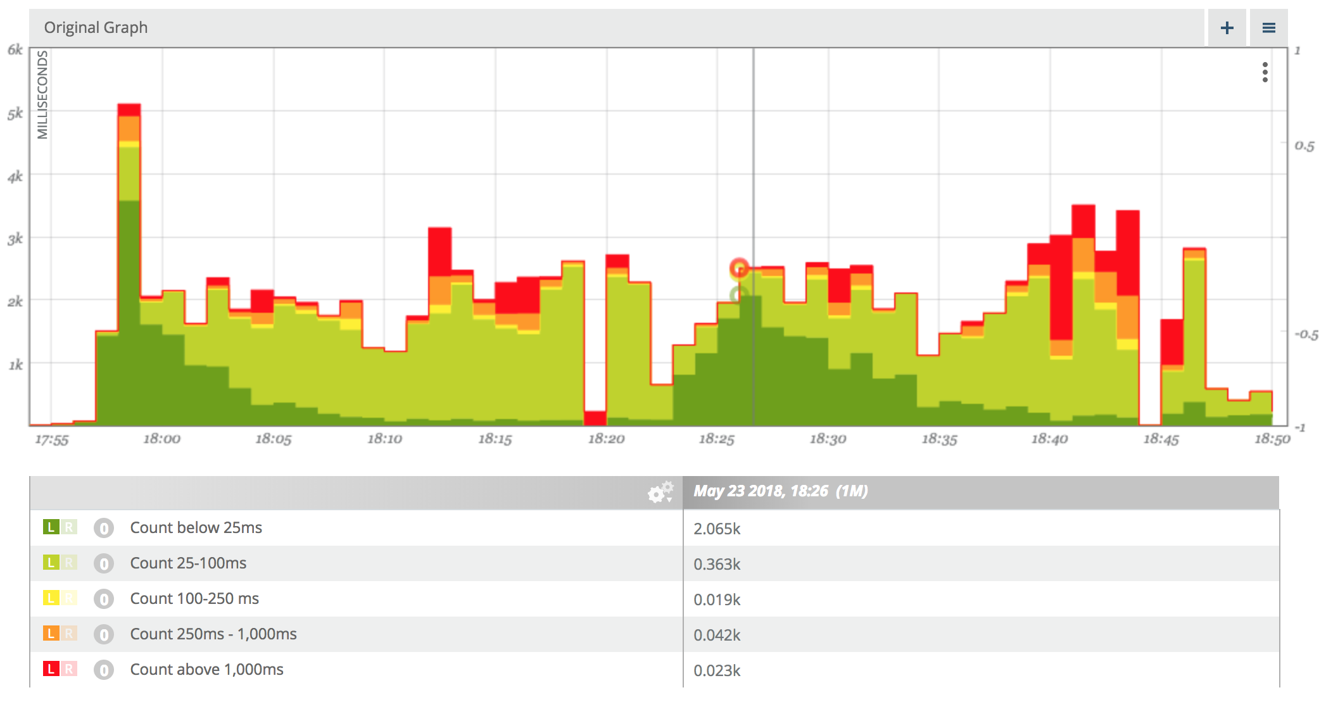
Latency Bands
@phredmoyer
Notes:
This visualization shows latency distribution broken down by latency bands over time. The bands here show the number of requests that took under 25ms, between 25 and 100 ms, 100-250ms, 250-1000, and over 1000ms. The colors are grouped by fast requests as shown in green, to slow requests shown in red.
What does this visualization tell us? It shows that requests to our service started off very quickly, and then the percentage of fast requests dropped off after a few minutes, and the percentage of slow requests increased after about 10 minutes. This pattern repeated itself for two traffic sessions.
What does that tell us about provisioning? Well, it suggests that initially the service was over provisioned, but then became under provisioned over the course of 10-20 minutes. Sounds like a good candidate for autoscaling.
We can add this type of visualization to our RED dashboard also. This type of visualization is excellent for communicating with business stakeholders, as it doesn’t require a lot of technical knowledge investment by them to understand the impact on the business.

Slide 84
Talk Agenda
Istio Overview
Exercises
Istio Mixer Metrics Adapters
Exercises
Math and Statistics
Exercises
SLOs / RED Dashboards
@phredmoyer
Notes:
So just a quick overview of the the talk roadmap. I’ll first give an overview of Istio and why it is awesome, then I’ll do a brief refresher on service level objectives to set a baseline. We’ll look at what a Red dashboard is and how we can make it more awesome with histogram based telemetry. Then I’ll do a brief walkthrough of the Istio metrics adapter I wrote, and finish up with a couple examples of how we can ask the right questions of the services we are monitoring.

Slide 85
Conclusions
Monitor services, not containers
Record distributions, not aggregates
Istio gives you RED metrics for free
Use math to ask the right questions
@phredmoyer
Notes:
Conclusions
We should monitor services, not containers. Services are long lived entities, containers are not. Your bosses doesn’t care how your containers are performing, they care about how your services are performing.
Record distributions, not aggregates. But generate aggregates from those distributions. Aggregates are very valuable sources of information, but unmergeable and not well suited to statistical analysis.
Istio gives you a lot of stuff for free. You don’t have to instrument your code either. You don’t need to go and build a high quality application framework from scratch.
Use math to ask questions about your services that are important to the business. That’s what this is all about, right? When we can make systems reliable by answering questions that the business values, we achieve the goals of the organization.

Slide 86
Thank you! Questions?
Tweet me @phredmoyer
@phredmoyer
Notes:
Thanks folks, I saved my obligatory proud parent photo for the end.
Happy to answer any questions now.

